Slide 1
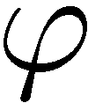
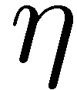
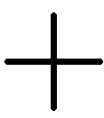
Coherence and Decoherence on fundamental sensitivity limits of quantum probes in metrology and computation
R. Demkowicz-Dobrzański¹, K. Banaszek¹, J. Kołodyński¹, M. Jarzyna¹, M. Markiewicz, M. Guta², K. Macieszczak^{1,2}, R. Schnabel³, M. Fraas^{4,} L. Maccone^{5,}
¹Faculty of Physics, University of Warsaw, Poland
² School of Mathematical Sciences, University of Nottingham, United Kingdom
³ Max-Planck-Institut fur Gravitationsphysik, Hannover, Germany ⁴ Theoretische Physik, ETH Zurich, Switzerland
⁵ Universit`a di Pavia, Italy.
Notes:
abstract mathematics allows to tell something about real physical phenomena

Slide 2
Long, long time ago…
Look for mathematical structures lying behind, do not focus on details!
You can multiply or divide different quantities, lengths of sticks by widths of hats and you can arrive at various constants and non-constants, Stanisław Lem, „The Investigation”

Slide 3
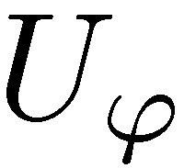
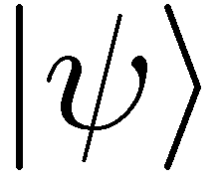
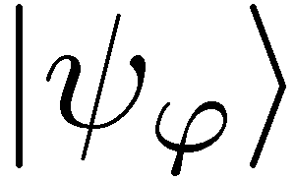
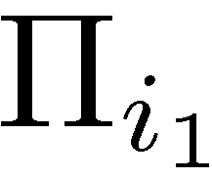
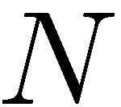
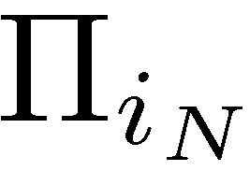
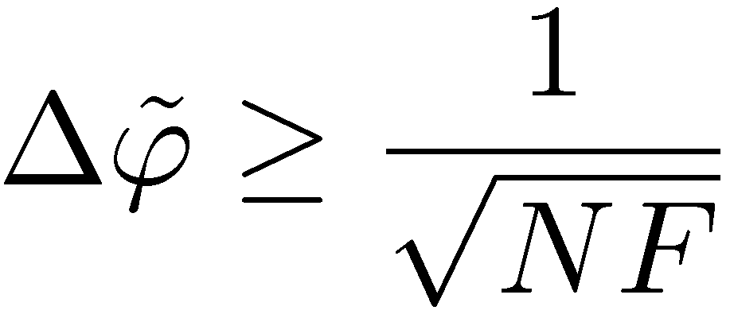
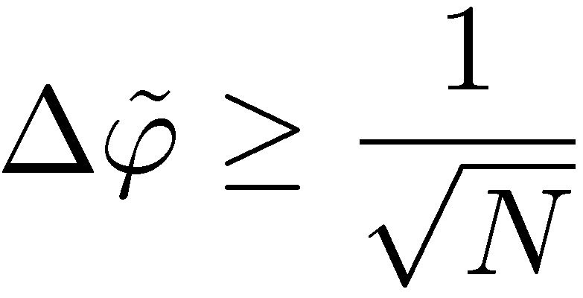
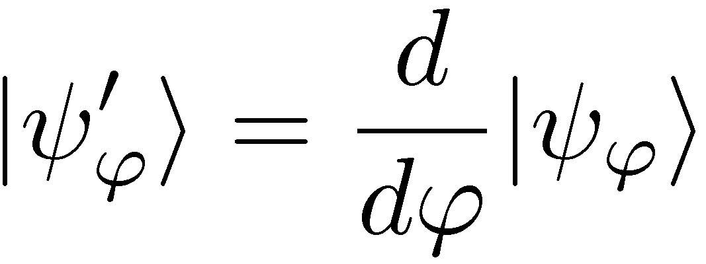
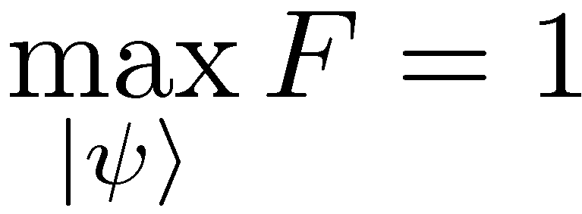
Entanglement-enhanced metrology
Quantum Fisher Information

Slide 4
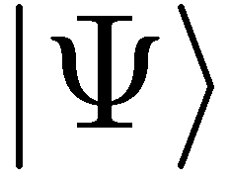
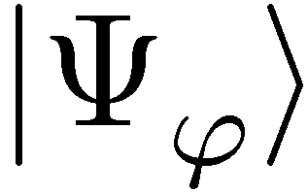
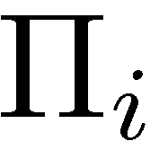
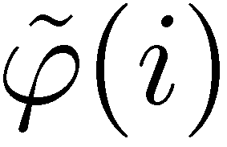
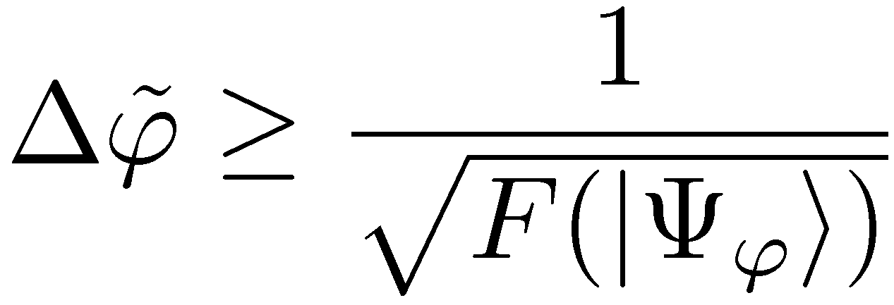
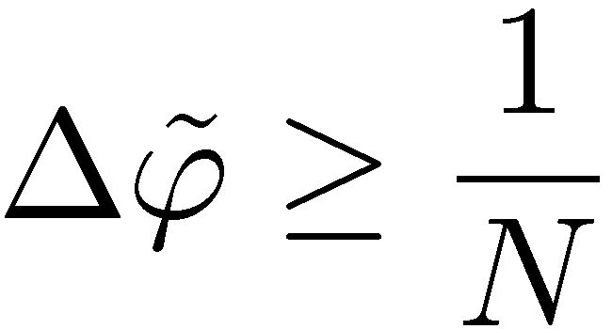
Entanglement-enhanced metrology
quadratic precision enhancement

Slide 5
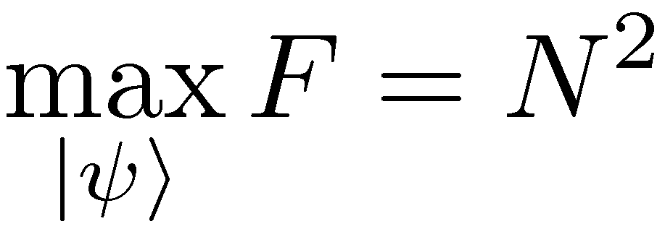
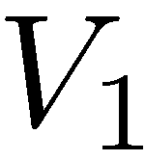
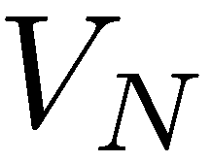
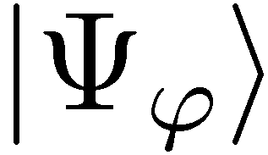
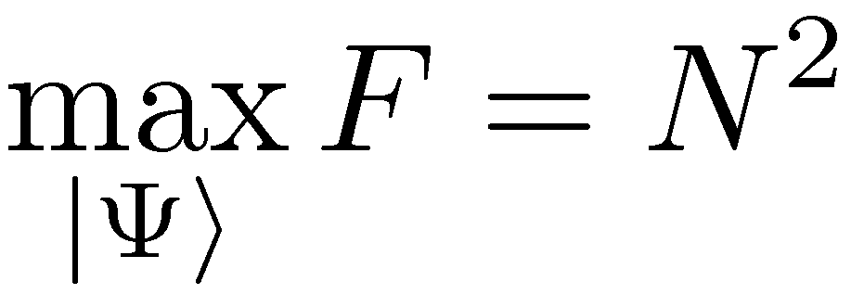
Coherence will also do…
The most general scheme (adaptive, ancilla assisted)…
If the number of channel uses is a resource, entanglement is useless
V. Giovannetti, S. Lloyd, and L. Maccone, Phys. Rev. Lett. 96, 010401 (2006).

Slide 6
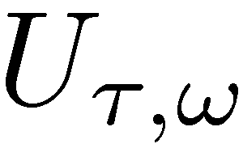
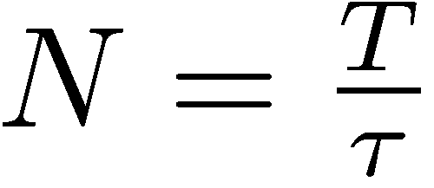
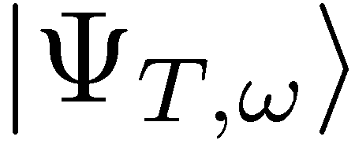
Frequency vs phase estimation
Estimate frequnecy, for total interrogation time T
Quantum gain thanks to a coherent evolution

Slide 7
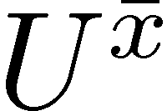
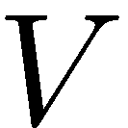
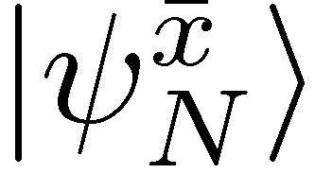
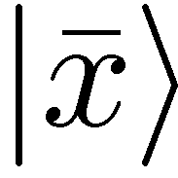
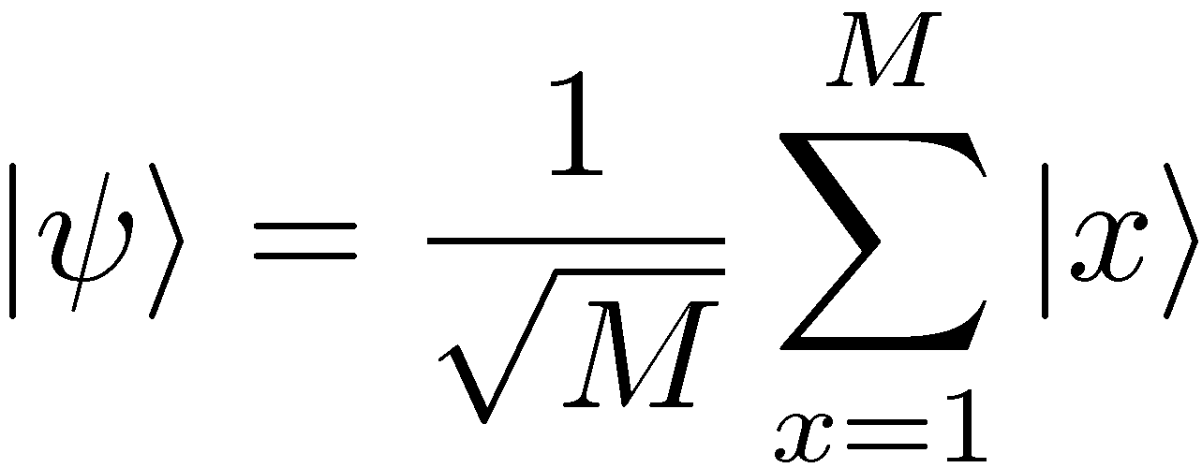
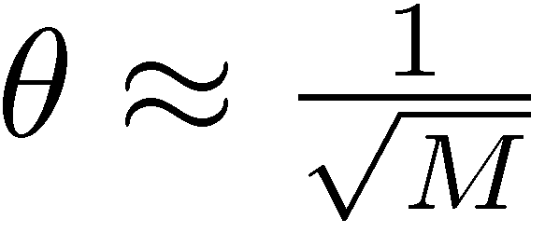
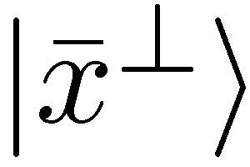
Just as in the Grover algorithm
Number of oracle calls to find the distinguished state:
Quadratic enhancement just as in metrology

Slide 8
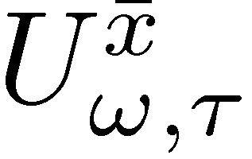
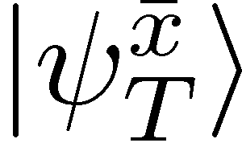
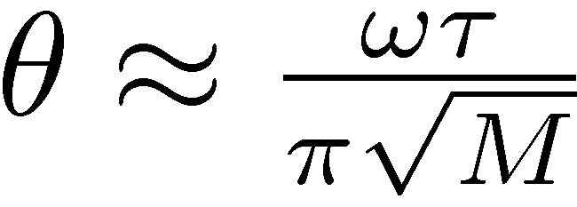
Continuous version of the Grover algorithm
Total interrogation time required
Interrogation time required reduced as in metrology

Slide 9
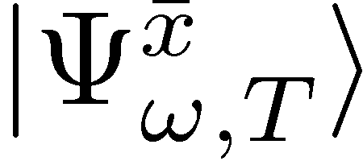
Grover and Metrology two sides of the same coin
Under total interrogation time T fixed
Notes:
We want the output state to evolve as far as possible from initial state

Slide 10
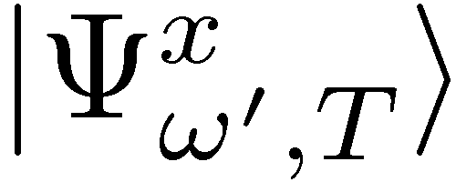
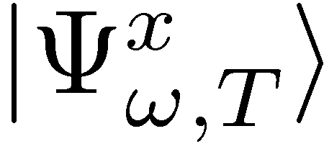
Limit on how fast probe states can become distinguishable?
Fix oracle index x
reference state
Bures distance:
By triangle inequality:

Slide 11
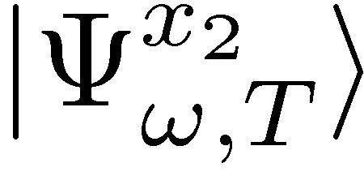
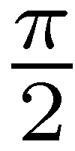
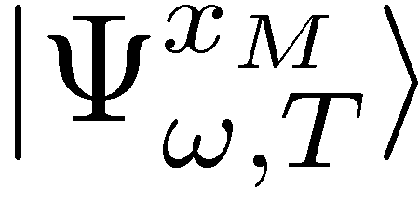
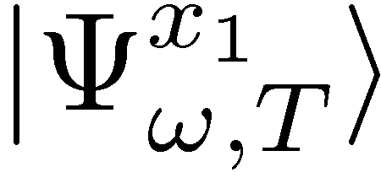
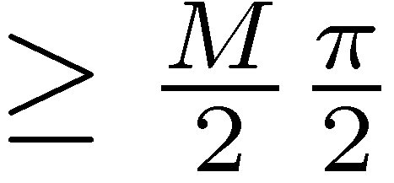
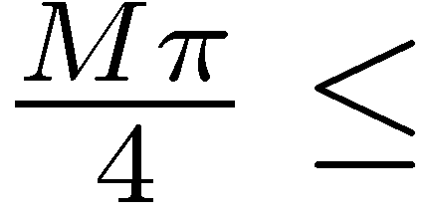
What Grover needs…
Final states should be distinguishable
We know that
too week
Probe needs to be sensitive to all oracles simultaneously !!!
Grover is optimal

Slide 12
Impact of decoherence

Slide 13
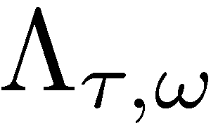
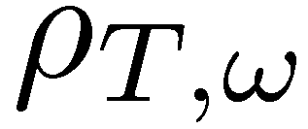
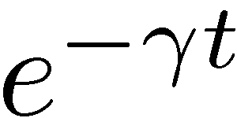
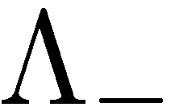
Frequency estimation under dephasing noise
Fundamental bound on Quantum Fisher Information (parallel setting)
B. M. Escher, R. L. de Matos Filho, L. Davidovich Nature Phys. 7, 406–411 (2011)
RDD, J. Kolodynski, M. Guta, Nature Communications 3, 1063 (2012)
RDD, L. Maccone Phys. Rev. Lett. 113, 250801 (2014)
(Valid also for most general adaptive strategy!)

Slide 14
Proof of the bound
If we can simmulate evolution of the channel (locally) by changing mixing porbabilities…
Then by Quantum Fisher Information of nonincreasing under CP maps we have:
=

Slide 15
Proof of the bound
Remark: without entanglement we could get:
S. Huelga et al. Phys.Rev.Lett. 79, 3865 (1997)

Slide 16
Grover with imperfect oracles
dephasing in M dimensional space – all off-diagonal elements multiplied by
conjecture
Grover quadratic speed-up lost
RDD, M. Markiewicz, arXiv:1412.6111 (2014)
Notes:
We want the output state to evolve as far as possible from initial state

Slide 17
Summary
RDD, K. Banaszek, R. Schnabel, Phys. Rev. A 88, 041802(R) (2013)
work in progress….
GW detectors sensitivity limits
Atomic-clocks stability limits
Quantum metrological bounds
RDD, M. Markiewicz, arXiv:1412.6111 (2014)
Quantum computing speed-up limits
Review paper:Quantum limits in optical interferometry , RDD, M.Jarzyna, J. Kolodynski,arXiv:1405.7703 (2014)

